Slide 1
Employee Attrition Prediction for HR Using Machine Learning
Submitted By
ARPan Majumdar
Internship Project
Technologies Used
Python | Machine Learning | Random Forest | Jupyter Notebook

Slide 2
Introduction
Employee attrition refers to employees leaving an organization either voluntarily or involuntarily.
High attrition rates increase recruitment costs, reduce productivity, and impact organizational performance.
Machine learning can help predict employee attrition and assist HR departments in improving employee retention.

Slide 3
Problem Statement
Organizations often struggle to identify employees who are likely to leave.
Unexpected employee turnover leads to:
Increased hiring costs
Loss of skilled employees
Reduced productivity
This project aims to predict employee attrition using machine learning techniques.

Slide 4
Objectives
Analyze employee data
Predict employee attrition
Identify important factors affecting attrition
Improve employee retention strategies
Support HR decision-making

Slide 5
Dataset Description
Dataset Used
IBM HR Analytics Employee Attrition Dataset
Dataset includes:
Age
Gender
Education
Job Role
Monthly Income
Overtime
Job Satisfaction
Work-Life Balance
Attrition Status

Slide 6
Technologies Used
Python
Pandas
NumPy
Matplotlib
Seaborn
Scikit-learn
Jupyter Notebook

Slide 7
Methodology
Step 1
Data Collection
Step 2
Data Preprocessing
Step 3
Exploratory Data Analysis
Step 4
Feature Encoding
Step 5
Model Training
Step 6
Prediction & Evaluation

Slide 8
Machine Learning Algorithm
Random Forest Classifier
Why Random Forest?
High Accuracy
Handles Large Datasets
Reduces Overfitting
Suitable for Classification Problems
The model was trained to predict employee attrition.

Slide 9
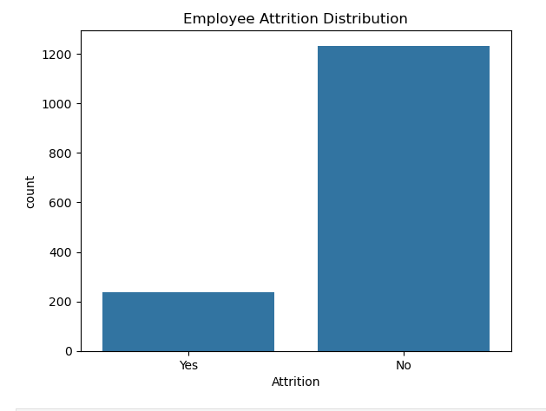
Data Visualization
Employee Attrition Distribution
The graph shows the number of
employees who stayed and
those who left the company.

Slide 10
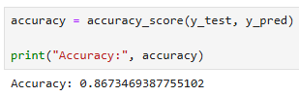
Model Performance
Accuracy Result
Accuracy Achieved
86.73%

Slide 11
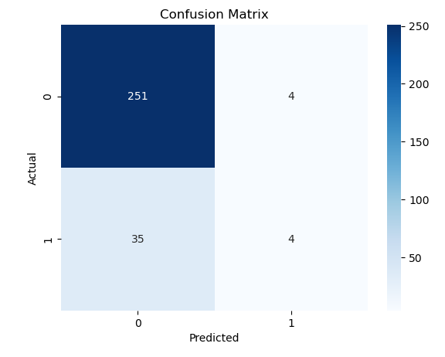
Confusion Matrix
The confusion matrix
compares actual employee
attrition with predicted
attrition and helps evaluate
model performance.

Slide 12
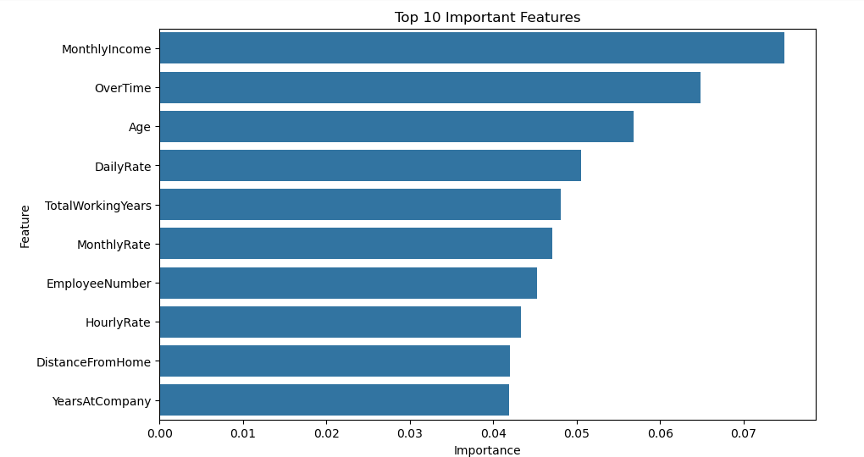
Feature Importance
Top Features Affecting
Attrition
Important Factors:
Overtime
Monthly Income
Job Role
Years at Company
Job Satisfaction

Slide 13
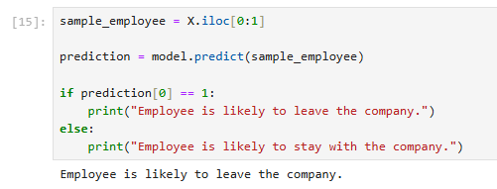
Final Prediction
Prediction Result
Example Output:
Employee is likely to leave the company.

Slide 14
Advantages
Advantages of the Project
Improves employee retention
Reduces hiring costs
Supports HR planning
Data-driven decision making
Predicts employee turnover

Slide 15
Conclusion
The Employee Attrition Prediction model successfully predicts employee turnover using machine learning.
The Random Forest Classifier achieved an accuracy of 86.73% and can assist organizations in identifying employees who are likely to leave.
This helps HR departments implement proactive retention strategies.

